Slide 1
Smart Public Restrooms
Introduction :
Smart public restrooms are a modern and innovative approach to designing and managing public restroom facilities. The incorporate various technologies and features to enhance the user experience, improve hygiene, and optimize maintenance. Here are some key components and features of smart public restrooms:

Slide 2
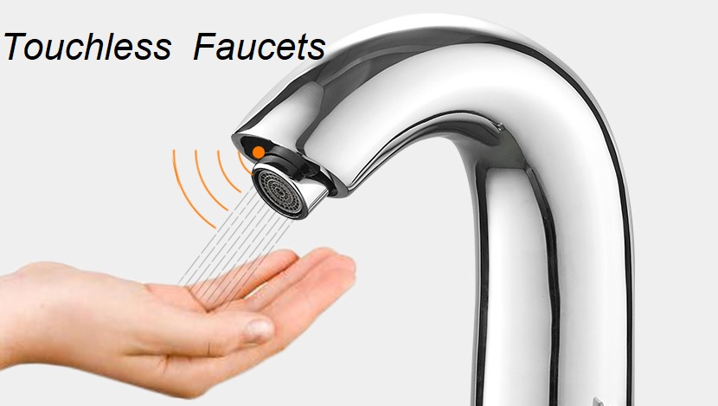
Automated Sensors :
Smart restrooms often feature automated sensors for faucets, soap dispensers, and hand dryers. These sensors minimize physical contact and promote hygiene by reducing the spread of germs.: Smart restrooms often feature automated sensors for faucets, soap dispensers, and hand dryers. These sensors minimize physical contact and promote hygiene by reducing the spread of germs.

Slide 3
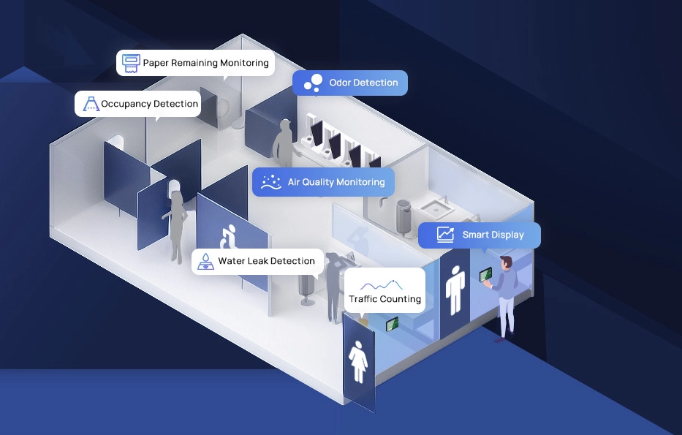
Occupancy Monitoring :
Real-time occupancy monitoring systems can help users find available restrooms, reducing wait times and improving the overall restroom experience. These systems can be integrated with mobile apps or displayed on digital signage.

Slide 4
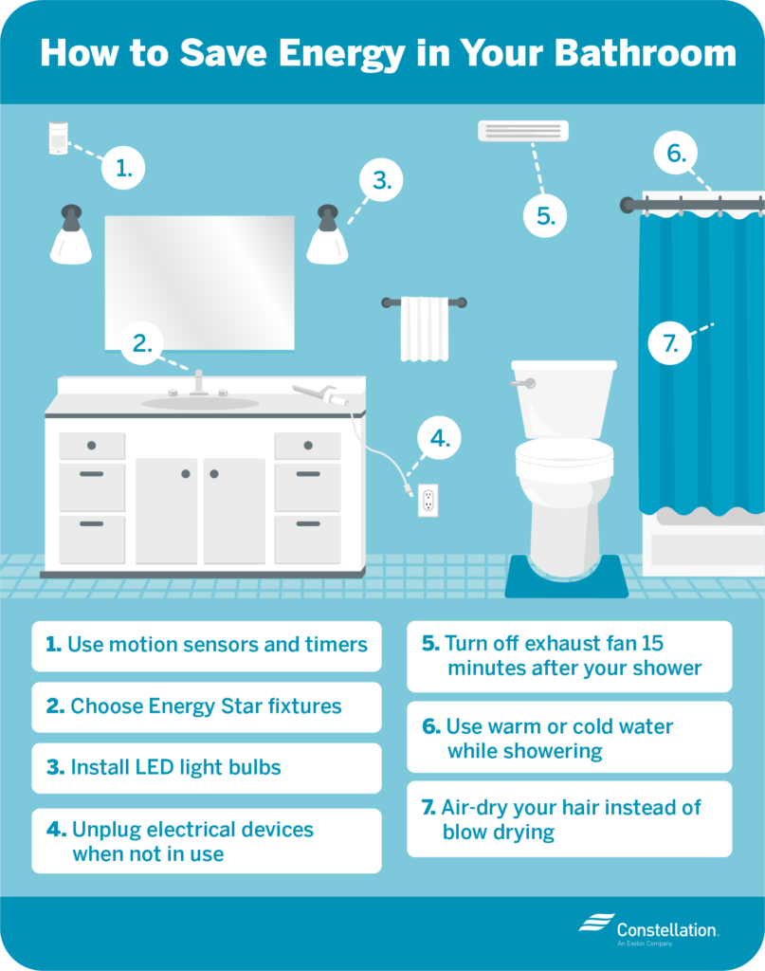
Energy Efficiency :
Energy-efficient lighting and heating/cooling systems help reduce energy consumption in public restrooms, contributing to sustainability efforts.

Slide 5
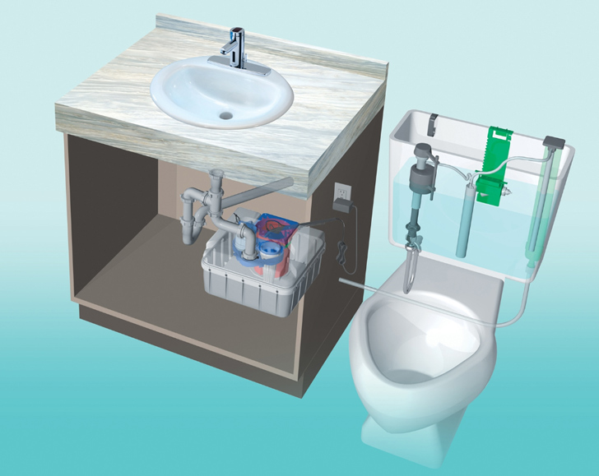
Water Efficiency :
Low-flow toilets and water-saving fixtures help conserve water and reduce the environmental impact of public restrooms.

Slide 6
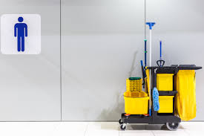
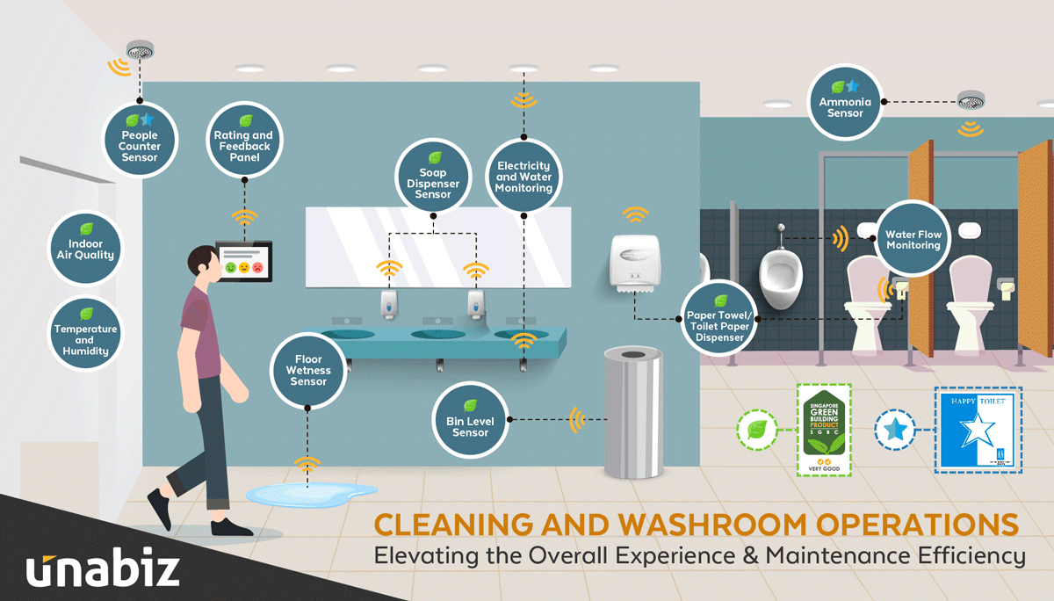
Cleanliness and Maintenance :
Smart restrooms can feature sensors that monitor restroom cleanliness and maintenance needs. When a restroom requires cleaning or restocking, an alert can be sent to custodial staff for quick response.

Slide 7
Conclusion :
Smart public restrooms are becoming more prevalent in urban areas, airports, shopping malls, and other high-traffic locations as they offer a more pleasant and convenient experience for users and help manage the maintenance and operation of these essential facilities efficiently.

